Slide 1
Computer Networking
Slide Set 3
Andrew W. Moore
Andrew.Moore@cl.cam.ac.uk

Slide 2
Topic 5 – Transport
Our goals:
understand principles behind transport layer services:
multiplexing/demultiplexing
reliable data transfer
flow control
congestion control
buffers
learn about transport layer protocols in the Internet:
UDP: connectionless transport
TCP: connection-oriented transport
TCP congestion control
TCP flow control

Slide 3

Transport Layer
Commonly a layer at end-hosts, between the application and network layer
Application
Application
Transport
Transport
Network
Network
Network
Datalink
Datalink
Datalink
Physical
Physical
Physical
Router
Host A
Host B

Slide 4
Why a transport layer?
IP packets are addressed to a host but end-to-end communication is between application/ processes/tasks at hosts
Need a way to decide which packets go to which applications (more multiplexing)

Slide 5
Why a transport layer?
Application
Application
Transport
Transport
Network
Network
Datalink
Datalink
Physical
Physical
Host A
Host B

Slide 6
Why a transport layer?
many application processes
browser
telnet
ftp
browser
mmedia
Application
Operating System
Transport
Network
IP
Datalink
Physical
Drivers +NIC
Datalink
Physical
Host A
Host B

Slide 7
Why a transport layer?
many application processes
Communication between processes
at hosts
telnet
ftp
HTTP server
ftp
browser
telnet
browser
mmedia
Transport
Transport
IP
IP
Datalink
Physical
Datalink
Physical
Communication between hosts
(128.4.5.6 ←→162.99.7.56)
Host A
Host B

Slide 8
Why a transport layer?
IP packets are addressed to a host but end-to-end communication is between application processes at hosts
Need a way to decide which packets go to which applications (mux/demux)
IP provides a weak service model (best-effort)
Packets can be corrupted, delayed, dropped, reordered, duplicated
No guidance on how much traffic to send and when
Dealing with this is tedious for application developers

Slide 9
Role of the Transport Layer
Communication between application processes
Multiplexing between application processes
Implemented using ports
Notes:
come back here 18-Feb-19

Slide 10
Role of the Transport Layer
Communication between application processes
Provide common end-to-end services for app layer [optional]
Reliable, in-order data delivery
Paced data delivery: flow and congestion-control
too fast may overwhelm the network
too slow is not efficient
(Just Like Computer Networking Lectures….)

Slide 11
Role of the Transport Layer
Communication between processes
Provide common end-to-end services for app layer [optional]
TCP and UDP are the common transport protocols
also SCTP, MTCP, SST, RDP, DCCP, …

Slide 12
Role of the Transport Layer
Communication between processes
Provide common end-to-end services for app layer [optional]
TCP and UDP are the common transport protocols
UDP is a minimalist, no-frills transport protocol
only provides mux/demux capabilities

Slide 13
Role of the Transport Layer
Communication between processes
Provide common end-to-end services for app layer [optional]
TCP and UDP are the common transport protocols
UDP is a minimalist, no-frills transport protocol
TCP is the totus porcus protocol
offers apps a reliable, in-order, byte-stream abstraction
with congestion control
but no performance (delay, bandwidth, ...) guarantees

Slide 14
Role of the Transport Layer
Communication between processes
mux/demux from and to application processes
implemented using ports

Slide 15
Context: Applications and Sockets
Socket: software abstraction by which an application process exchanges network messages with the (transport layer in the) operating system
socketID = socket(…, socket.TYPE)
socketID.sendto(message, …)
socketID.recvfrom(…)
Two important types of sockets
UDP socket: TYPE is SOCK_DGRAM
TCP socket: TYPE is SOCK_STREAM

Slide 16
Ports
Problem: deciding which app (socket) gets which packets
Solution: port as a transport layer identifier
16 bit identifier
OS stores mapping between sockets and ports
a packet carries a source and destination port number in its transport layer header
For UDP ports (SOCK_DGRAM)
OS stores (local port, local IP address) ←→ socket
For TCP ports (SOCK_STREAM)
OS stores (local port, local IP, remote port, remote IP) ←→ socket

Slide 17
4-bit
Version
4-bit
Header
Length
8-bit
Type of Service
(TOS)
16-bit Total Length (Bytes)
16-bit Identification
3-bit
Flags
13-bit Fragment Offset
8-bit Time to
Live (TTL)
8-bit Protocol
16-bit Header Checksum
32-bit Source IP Address
32-bit Destination IP Address
Options (if any)
IP Payload
Notes:
Go through very fast

Slide 18
4
5
8-bit
Type of Service
(TOS)
16-bit Total Length (Bytes)
16-bit Identification
3-bit
Flags
13-bit Fragment Offset
8-bit Time to
Live (TTL)
8-bit Protocol
16-bit Header Checksum
32-bit Source IP Address
32-bit Destination IP Address
IP Payload
Notes:
Go through very fast

Slide 19
4
5
8-bit
Type of Service
(TOS)
16-bit Total Length (Bytes)
16-bit Identification
3-bit
Flags
13-bit Fragment Offset
8-bit Time to
Live (TTL)
6 = TCP 17 = UDP
16-bit Header Checksum
32-bit Source IP Address
32-bit Destination IP Address
TCP or
UDP
header and Payload
Notes:
Go through very fast

Slide 20
4
5
8-bit
Type of Service
(TOS)
16-bit Total Length (Bytes)
16-bit Identification
3-bit
Flags
13-bit Fragment Offset
8-bit Time to
Live (TTL)
6 = TCP 17 = UDP
16-bit Header Checksum
32-bit Source IP Address
32-bit Destination IP Address
16-bit Source Port
16-bit Destination Port
More transport header fields ….
TCP or
UDP
header and Payload
Notes:
Go through very fast

Slide 21
Recap: Multiplexing and Demultiplexing
Host receives IP packets
Each IP header has source and destination IP address
Each Transport Layer header has source and destination port number
Host uses IP addresses and port numbers to direct the message to appropriate socket

Slide 22
More on Ports
Separate 16-bit port address space for UDP and TCP
“Well known” ports (0-1023): everyone agrees which services run on these ports
e.g., ssh:22, http:80, https:443
helps client know server’s port
Ephemeral ports (most 1024-65535): dynamically selected: as the source port for a client process

Slide 23
UDP: User Datagram Protocol
Lightweight communication between processes
Avoid overhead and delays of ordered, reliable delivery
UDP described in RFC 768 – (1980!)
Destination IP address and port to support demultiplexing
Optional error checking on the packet contents
(checksum field of 0 means “don’t verify checksum”) not in IPv6!
((this idea of optional checksum is removed in IPv6))
SRC port
DST port
checksum
length
DATA

Slide 24
Why a transport layer?
IP packets are addressed to a host but end-to-end communication is between application processes at hosts
Need a way to decide which packets go to which applications (mux/demux)
IP provides a weak service model (best-effort)
Packets can be corrupted, delayed, dropped, reordered, duplicated
Notes:
2020-2-19

Slide 25
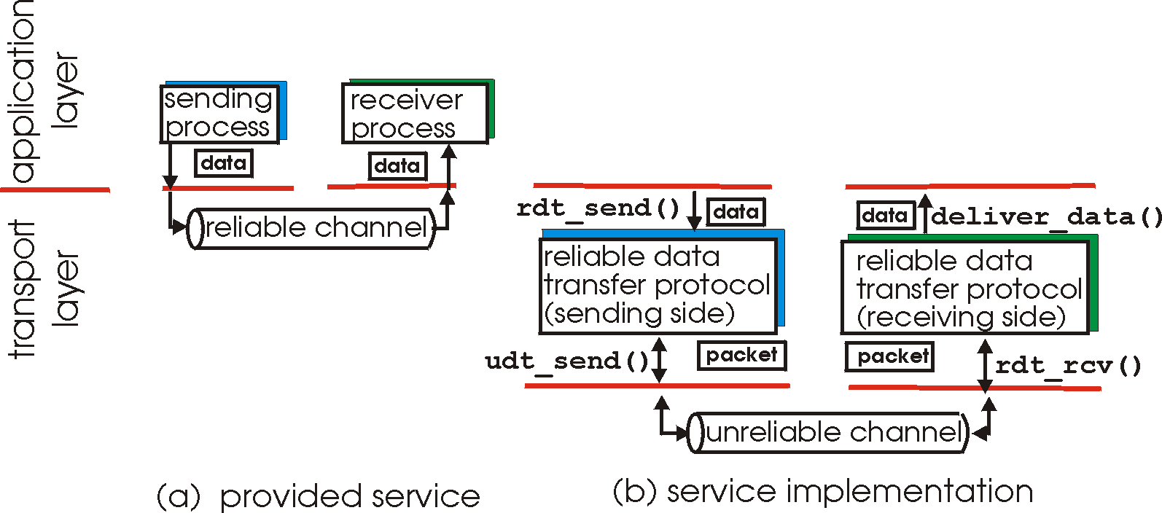
Principles of Reliable data transfer
important in app., transport, link layers
top-10 list of important networking topics!
In a perfect world, reliable transport is easy
But the Internet default is best-effort
All the bad things best-effort can do
a packet is corrupted (bit errors)
a packet is lost
a packet is delayed (why?)
packets are reordered (why?)
a packet is duplicated (why?)
Notes:
MAKE CLEAR THE OBJECTIVE (function)
- RELIABLE data transfer

Slide 26
Principles of Reliable data transfer
important in app., transport, link layers
top-10 list of important networking topics!
characteristics of unreliable channel will determine complexity of reliable data transfer protocol (rdt)

Slide 27
Principles of Reliable data transfer
important in app., transport, link layers
top-10 list of important networking topics!
rdt_rcv()
udt_rcv()
characteristics of unreliable channel will determine complexity of reliable data transfer protocol (rdt)

Slide 28
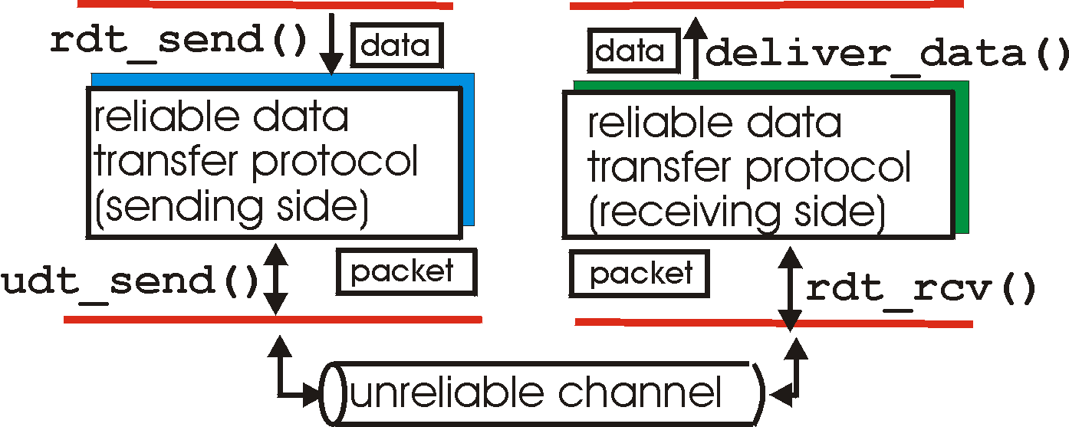
Reliable data transfer: getting started
rdt_send(): called from above, (e.g., by app.). Passed data to
deliver to receiver upper layer
rdt_rcv(): called by rdt to deliver data to upper
rdt_rcv()
send
side
receive
side
udt_rcv()
udt_send(): called by rdt,
to transfer packet over
unreliable channel to receiver
udt_rcv(): called when packet arrives on rcv-side of channel

Slide 29
Reliable data transfer: getting started
We’ll:
incrementally develop sender, receiver sides of reliable data transfer protocol (rdt)
consider only unidirectional data transfer
but control info will flow on both directions!
use finite state machines (FSM) to specify sender, receiver
event causing state transition
actions taken on state transition
state: when in this “state” next state uniquely determined by next event
state
1
state
2
event
actions

Slide 30
KR state machines – a note.
Beware
Kurose and Ross has a confusing/confused attitude to state-machines.
I’ve attempted to normalise the representation.
UPSHOT: these slides have differing information to the KR book (from which the RDT example is taken.)
in KR “actions taken” appear wide-ranging, my interpretation is more specific/relevant.
Relevant event causing state transition
state: when in this “state” next state uniquely determined by next event
Relevant action taken on state transition
State
name
State
name
event
actions

Slide 31
Rdt1.0: reliable transfer over a reliable channel
underlying channel perfectly reliable
no bit errors
no loss of packets
separate FSMs for sender, receiver:
sender sends data into underlying channel
receiver read data from underlying channel
Event
rdt_send(data)
udt_rcv(packet)
IDLE
udt_send(packet)
IDLE
rdt_rcv(data)
Action
sender
receiver

Slide 32
Rdt2.0: channel with bit errors
underlying channel may flip bits in packet
checksum to detect bit errors
the question: how to recover from errors:
acknowledgements (ACKs): receiver explicitly tells sender that packet received is OK
negative acknowledgements (NAKs): receiver explicitly tells sender that packet had errors
sender retransmits packet on receipt of NAK
new mechanisms in rdt2.0 (beyond rdt1.0):
error detection
receiver feedback: control msgs (ACK,NAK) receiver->sender

Slide 33
Dealing with Packet Corruption
1
☑
ack
2
☒
nack
.
.
.
2
Sender
Receiver
Time

Slide 34
rdt2.0: FSM specification
rdt_send(data)
udt_send(packet)
receiver
udt_rcv(reply) &&
isNAK(reply)
Waiting
for reply
udt_rcv(packet) && corrupt(packet)
IDLE
udt_send(packet)
udt_send(NAK)
udt_rcv(reply) && isACK(reply)
Λ
IDLE
sender
udt_rcv(packet) && notcorrupt(packet)
Note: the sender holds a copy of the packet being sent until the delivery is acknowledged.
rdt_rcv(data)
udt_send(ACK)

Slide 35
rdt2.0: operation with no errors
rdt_send(data)
udt_send(packet)
udt_rcv(reply) &&
isNAK(reply)
Waiting
for reply
udt_rcv(packet) && corrupt(packet)
IDLE
udt_send(packet)
udt_send(NAK)
udt_rcv(reply) && isACK(reply)
Λ
IDLE
udt_rcv(packet) && notcorrupt(packet)
rdt_rcv(data)
udt_send(ACK)

Slide 36
rdt2.0: error scenario
rdt_send(data)
udt_send(packet)
udt_rcv(reply) &&
isNAK(reply)
Waiting
for reply
udt_rcv(packet) && corrupt(packet)
IDLE
udt_send(packet)
udt_send(NAK)
udt_rcv(reply) && isACK(reply)
Λ
IDLE
udt_rcv(packet) && notcorrupt(packet)
rdt_rcv(data)
udt_send(ACK)

Slide 37
rdt2.0 has a fatal flaw!
What happens if ACK/NAK corrupted?
sender doesn’t know what happened at receiver!
can’t just retransmit: possible duplicate
Handling duplicates:
sender retransmits current packet if ACK/NAK garbled
sender adds sequence number to each packet
receiver discards (doesn’t deliver) duplicate packet
stop and wait
Sender sends one packet,
then waits for receiver
response

Slide 38
Dealing with Packet Corruption
1
P(1)
☑
ack(1)
☒
1
P(1)
Packet #1 or #2?
This is packet #1
ack(1)
2
P(2)
Data and ACK packets carry sequence numbers
What if the ACK/NACK is corrupted?
Sender
Receiver
Time

Slide 39
rdt2.1: sender, handles garbled ACK/NAKs
rdt_send(data)
sequence=0
udt_send(packet)
udt_rcv(reply) &&
( corrupt(reply) ||
isNAK(reply) )
Waiting
For reply
IDLE
udt_send(packet)
udt_rcv(reply)
&& notcorrupt(reply)
&& isACK(reply)
udt_rcv(reply)
&& notcorrupt(reply)
&& isACK(reply)
Λ
Λ
Waiting
for reply
IDLE
udt_rcv(reply) &&
( corrupt(reply) ||
isNAK(reply) )
rdt_send(data)
udt_send(packet)
sequence=1
udt_send(packet)

Slide 40
rdt2.1: receiver, handles garbled ACK/NAKs
udt_rcv(packet) && not corrupt(packet)
&& has_seq0(packet)
udt_send(ACK)
rdt_rcv(data)
receive(packet) && corrupt(packet)
udt_rcv(packet) && corrupt(packet)
udt_send(NAK)
udt_send(NAK)
Wait for
0 from below
Wait for
1 from below
receive(packet) &&
not corrupt(packet) &&
has_seq1(packet)
receive(packet) &&
not corrupt(packet) &&
has_seq0(packet)
udt_send(ACK)
udt_send(ACK)
udt_rcv(packet) && not corrupt(packet)
&& has_seq1(packet)
udt_send(ACK)
rdt_rcv(data)

Slide 41
rdt2.1: discussion
Sender:
seq # added to pkt
two seq. #’s (0,1) will suffice. Why?
must check if received ACK/NAK corrupted
twice as many states
state must “remember” whether “current” pkt has a
0 or 1 sequence number
Receiver:
must check if received packet is duplicate
state indicates whether 0 or 1 is expected pkt seq #
note: receiver can not know if its last ACK/NAK received OK at sender

Slide 42
rdt2.2: a NAK-free protocol
same functionality as rdt2.1, using ACKs only
instead of NAK, receiver sends ACK for last pkt received OK
receiver must explicitly include seq # of pkt being ACKed
duplicate ACK at sender results in same action as NAK: retransmit current pkt

Slide 43
rdt2.2: sender, receiver fragments
rdt_send(data)
sequence=0
udt_send(packet)
rdt_rcv(reply) &&
( corrupt(reply) ||
isACK1(reply) )
Wait for call 0 from above
Wait for ACK
0
udt_send(packet)
sender FSM
fragment
udt_rcv(reply)
&& not corrupt(reply)
&& isACK0(reply)
udt_rcv(packet) &&
(corrupt(packet) ||
has_seq1(packet))
Λ
Wait for
0 from below
receiver FSM
fragment
udt_send(ACK1)
receive(packet) && not corrupt(packet)
&& has_seq1(packet)
send(ACK1)
rdt_rcv(data)

Slide 44
rdt3.0: channels with errors and loss
New assumption: underlying channel can also lose packets (data or ACKs)
checksum, seq. #, ACKs, retransmissions will be of help, but not enough
Approach: sender waits “reasonable” amount of time for ACK
retransmits if no ACK received in this time
if pkt (or ACK) just delayed (not lost):
retransmission will be duplicate, but use of seq. #’s already handles this
receiver must specify seq # of pkt being ACKed
requires countdown timer

Slide 45
rdt3.0 sender
rdt_send(data)
udt_rcv(reply) &&
( corrupt(reply) ||
isACK(reply,1) )
sequence=0
udt_send(packet)
udt_rcv(reply)
Λ
Λ
IDLE
state 0
Wait for ACK0
timeout
udt_send(packet)
udt_rcv(reply)
&& notcorrupt(reply)
&& isACK(reply,1)
udt_rcv(reply)
&& notcorrupt(reply)
&& isACK(reply,0)
Λ
Λ
Wait for ACK1
IDLE
state 1
timeout
udt_send(packet)
udt_rcv(reply)
rdt_send(data)
Λ
udt_rcv(packet) &&
( corrupt(packet) ||
isACK(reply,0) )
sequence=1
udt_send(packet)
Λ

Slide 46
Dealing with Packet Loss
1
P(1)
☒
Timeout
1
P(1)
ack(1)
P(2)
Sender
Receiver
Timer-driven loss detection Set timer when packet is sent; retransmit on timeout
Time

Slide 47
Dealing with Packet Loss
1
P(1)
Timeout
☒
1
P(1)
duplicate!
ack(1)
P(2)
Sender
Receiver
Time

Slide 48
Dealing with Packet Loss
1
P(1)
Timeout
1
P(1)
ack(1)
.
.
.
duplicate!
ack(1)
P(2)
Sender
Receiver
Timer-driven retx. can lead to duplicates
Time

Slide 49
Performance of rdt3.0
rdt3.0 works, but performance stinks
ex: 1 Gbps link, 15 ms prop. delay, 8000 bit packet:
U _{sender}: utilization – fraction of time sender busy sending
1KB pkt every 30 msec -> 33kB/sec throughput over 1 Gbps link
network protocol limits use of physical resources!

Slide 50
rdt3.0: stop-and-wait operation
sender
receiver
Inefficient if
t << RTT
first packet bit transmitted, t = 0
last packet bit transmitted, t = L / R
first packet bit arrives
RTT
last packet bit arrives, send ACK
ACK arrives, send next
packet, t = RTT + L / R
Notes:
29th end

Slide 51
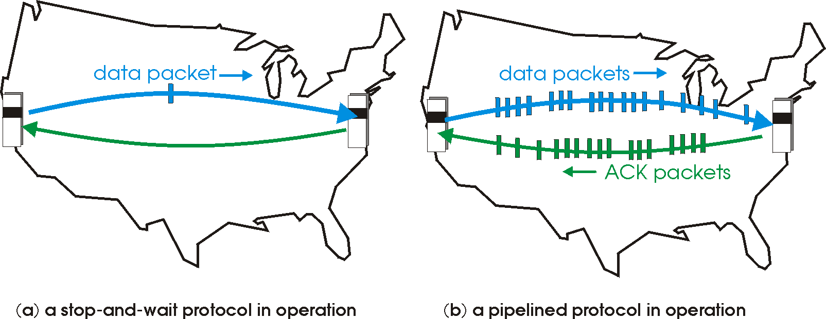
Pipelined (Packet-Window) protocols
Pipelining: sender allows multiple, “in-flight”, yet-to-be-acknowledged pkts
range of sequence numbers must be increased
buffering at sender and/or receiver

Slide 52
A Sliding Packet Window
window = set of adjacent sequence numbers
The size of the set is the window size; assume window size is n
General idea: send up to n packets at a time
Sender can send packets in its window
Receiver can accept packets in its window
Window of acceptable packets “slides” on successful reception/acknowledgement

Slide 53
A Sliding Packet Window
Let A be the last ack’d packet of sender without gap;
then window of sender = {A+1, A+2, …, A+n}
Let B be the last received packet without gap by receiver,
then window of receiver = {B+1,…, B+n}
n
Already ACK’d
A
Sent but not ACK’d
Cannot be sent
sequence number →
n
Received and ACK’d
B
Acceptable but not yet received
Cannot be received

Slide 54
Acknowledgements w/ Sliding Window
Two common options
cumulative ACKs: ACK carries next in-order sequence number that the receiver expects
Notes:
27-1-2016

Slide 55
Cumulative Acknowledgements (1)
At receiver
n
Received and ACK’d
B
Acceptable but not yet received
Cannot be received
After receiving B+1, B+2
B_{new}= B+2
n
Receiver sends ACK(B_{new}+1)

Slide 56
Cumulative Acknowledgements (2)
At receiver
n
Received and ACK’d
B
Acceptable but not yet received
Cannot be received
After receiving B+4, B+5
B
n
How do we recover?
Receiver sends ACK(B+1)

Slide 57
Go-Back-N (GBN)
Sender transmits up to n unacknowledged packets
Receiver only accepts packets in order
discards out-of-order packets (i.e., packets other than B+1)
Receiver uses cumulative acknowledgements
i.e., sequence# in ACK = next expected in-order sequence#
Sender sets timer for 1st outstanding ack (A+1)
If timeout, retransmit A+1, … , A+n

Slide 58
Sliding Window with GBN
Let A be the last ack’d packet of sender without gap;
then window of sender = {A+1, A+2, …, A+n}
Let B be the last received packet without gap by receiver,
then window of receiver = {B+1,…, B+n}
n
Already ACK’d
A
Sent but not ACK’d
Cannot be sent
sequence number →
n
Received and ACK’d
B
Acceptable but not yet received
Cannot be received

Slide 59
GBN Example w/o Errors
Sender Window
Window size = 3 packets
Receiver Window
{1}
1
{1, 2}
2
{1, 2, 3}
3
{2, 3, 4}
4
{3, 4, 5}
5
.
.
.
{4, 5, 6}
6
.
.
.
Sender
Receiver
Time

Slide 60
GBN Example with Errors
Window size = 3 packets
1
2
3
4
5
Timeout
Packet 4
6
4
5
6
Sender
Receiver

Slide 61
GBN Example with Errors - ALTERNATIVE
Window size = 3 packets
1
2
3
Timeout
Packet 2
4
2
3
4
Sender
Receiver

Slide 62
GBN: sender extended FSM
rdt_send(data)
if (nextseqnum < base+N) {
udt_send(packet[nextseqnum])
nextseqnum++
}
else
refuse_data(data) Block?
Λ
base=1
nextseqnum=1
timeout
Wait
udt_send(packet[base])
udt_send(packet[base+1])
…
udt_send(packet[nextseqnum-1])
udt_rcv(reply)
&& corrupt(reply)
Λ
udt_rcv(reply) &&
notcorrupt(reply)
base = getacknum(reply)+1

Slide 63
GBN: receiver extended FSM
Λ
udt_send(reply)
udt_rcv(packet)
&& notcurrupt(packet)
&& hasseqnum(rcvpkt,expectedseqnum)
Λ
Wait
rdt_rcv(data)
udt_send(ACK)
expectedseqnum++
expectedseqnum=1
ACK-only: always send an ACK for correctly-received packet with the highest in-order seq #
may generate duplicate ACKs
need only remember expectedseqnum
out-of-order packet:
discard (don’t buffer) -> no receiver buffering!
Re-ACK packet with highest in-order seq #
Notes:
come back here 19-2-19

Slide 64
Acknowledgements w/ Sliding Window
Two common options
cumulative ACKs: ACK carries next in-order sequence number the receiver expects
selective ACKs: ACK individually acknowledges correctly received packets
Selective ACKs offer more precise information but require more complicated book-keeping
Many variants that differ in implementation details
Notes:
2-Feb-2015 13-Feb-2017

Slide 65
Selective Repeat (SR)
Sender: transmit up to n unacknowledged packets
Assume packet k is lost, k+1 is not
Receiver: indicates packet k+1 correctly received
Sender: retransmit only packet k on timeout
Efficient in retransmissions but complex book-keeping
need a timer per packet

Slide 66
SR Example with Errors
Window size = 3 packets
{1}
1
{1, 2}
2
{1, 2, 3}
3
{2, 3, 4}
4
{3, 4, 5}
5
Timeout
Packet 4
{4, 5, 6}
6
ACK=5
{4,5,6}
ACK=6
4
{4,5,6}
Time
ACK=4
{7, 8, 9}
7
Sender
Receiver

Slide 67
Observations
With sliding windows, it is possible to fully utilize a link, provided the window size (n) is large enough. Throughput is ~ (n/RTT)
Stop & Wait is like n = 1.
Sender has to buffer all unacknowledged packets, because they may require retransmission
Receiver may be able to accept out-of-order packets, but only up to its buffer limits
Implementation complexity depends on protocol details (GBN vs. SR)

Slide 68
Recap: components of a solution
Checksums (for error detection)
Timers (for loss detection)
Acknowledgments
cumulative
selective
Sequence numbers (duplicates, windows)
Sliding Windows (for efficiency)
Reliability protocols use the above to decide when and what to retransmit or acknowledge

Slide 69
What does TCP do?
Most of our previous tricks + a few differences
Sequence numbers are byte offsets
Sender and receiver maintain a sliding window
Receiver sends cumulative acknowledgements (like GBN)
Sender maintains a single retx. timer
Receivers do not drop out-of-sequence packets (like SR)
Introduces fast retransmit : optimization that uses duplicate ACKs to trigger early retx
Introduces timeout estimation algorithms

Slide 70
Automatic Repeat Request (ARQ)
+ Self-clocking (Automatic)
+ Adaptive
+ Flexible
- Slow to start / adapt
consider high Bandwidth/Delay product
Next lets move from
the generic to the
specific….
TCP arguably the most successful protocol in the Internet…..
its an ARQ protocol

Slide 71
TCP Header
Source port
Destination port
Used to mux
and demux
Sequence number
Acknowledgment
HdrLen
0
Flags
Advertised window
Checksum
Urgent pointer
Options (variable)
Data

Slide 72
Last time: Components of a solution for reliable transport
Checksums (for error detection)
Timers (for loss detection)
Acknowledgments
cumulative
selective
Sequence numbers (duplicates, windows)
Sliding Windows (for efficiency)
Go-Back-N (GBN)
Selective Replay (SR)

Slide 73
What does TCP do?
Many of our previous ideas, but some key differences
Checksum

Slide 74
TCP Header
Source port
Destination port
Sequence number
Acknowledgment
Computed over header
and data
HdrLen
0
Flags
Advertised window
Checksum
Urgent pointer
Options (variable)
Data

Slide 75
What does TCP do?
Many of our previous ideas, but some key differences
Checksum
Sequence numbers are byte offsets

Slide 76
TCP: Segments and Sequence Numbers

Slide 77
TCP “Stream of Bytes” Service…
Application @ Host A
Byte 0
Byte 1
Byte 2
Byte 3
Byte 80
Byte 0
Byte 1
Byte 2
Byte 3
Byte 80
Application @ Host B

Slide 78
… Provided Using TCP “Segments”
Host A
Byte 0
Byte 1
Byte 2
Byte 3
Byte 80
Segment sent when:
Segment full (Max Segment Size),
Not full, but times out
TCP Data
TCP Data
Host B
Byte 0
Byte 1
Byte 2
Byte 3
Byte 80

Slide 79
TCP Segment
IP Data
TCP Data (segment)
TCP Hdr
IP Hdr
IP packet
No bigger than Maximum Transmission Unit (MTU)
E.g., up to 1500 bytes with Ethernet
TCP packet
IP packet with a TCP header and data inside
TCP header ≥ 20 bytes long
TCP segment
No more than Maximum Segment Size (MSS) bytes
E.g., up to 1460 consecutive bytes from the stream
MSS = MTU – (IP header) – (TCP header)

Slide 80
Sequence Numbers
ISN (initial sequence number)
k bytes
Host A
Sequence number = 1st byte in segment = ISN + k

Slide 81
Sequence Numbers
ISN (initial sequence number)
k
Host A
Sequence number = 1st byte in segment = ISN + k
TCP Data
TCP
HDR
ACK sequence number
= next expected byte
= seqno + length(data)
TCP Data
TCP
HDR
Host B

Slide 82
TCP Header
Starting byte offset of data
carried in this segment
Source port
Destination port
Sequence number
Acknowledgment
HdrLen
0
Flags
Advertised window
Checksum
Urgent pointer
Options (variable)
Data
Notes:
Number of first byte

Slide 83
Sequence Numbers
Sequence number = 1st byte in segment = ISN + k
Host B - > A
ACK
Host A
Sequence number
TCP
HDR
Acknowledgment
TCP Data
Data
Sequence number
Acknowledgment
TCP Data
TCP
HDR
Host B
Host A- > B
DATA
ACK sequence number
= next expected byte
= seqno + length(data)

Slide 84
TCP Sequences and ACKS
TCP is full duplex by default
two independently flows of sequence numbers
Sequence acknowledgement is given in terms of BYTES (not packets); the window is in terms of bytes.
number of packets = window size (bytes) / Segment Size
Servers and Clients are not Source and Destination
Piggybacking increases efficiency but many flows may only have data moving in one direction

Slide 85
What does TCP do?
Most of our previous tricks, but a few differences
Checksum
Sequence numbers are byte offsets
Receiver sends cumulative acknowledgements (like GBN)

Slide 86
ACKing and Sequence Numbers
Sender sends packet
Data starts with sequence number X
Packet contains B bytes [X, X+1, X+2, ….X+B-1]
Upon receipt of packet, receiver sends an ACK
If all data prior to X already received:
ACK acknowledges X+B (because that is next expected byte)
If highest in-order byte received is Y s.t. (Y+1) < X
ACK acknowledges Y+1
Even if this has been ACKed before

Slide 87
Normal Pattern
Sender: seqno=X, length=B
Receiver: ACK=X+B
Sender: seqno=X+B, length=B
Receiver: ACK=X+2B
Sender: seqno=X+2B, length=B
Seqno of next packet is same as last ACK field

Slide 88
TCP Header
Acknowledgment gives seqno just beyond highest seqno received in order
(“What Byte is Next”)
Source port
Destination port
Sequence number
Acknowledgment
HdrLen
0
Flags
Advertised window
Checksum
Urgent pointer
Options (variable)
Data

Slide 89
What does TCP do?
Most of our previous tricks, but a few differences
Checksum
Sequence numbers are byte offsets
Receiver sends cumulative acknowledgements (like GBN)
Receivers can buffer out-of-sequence packets (like SR)

Slide 90
Loss with cumulative ACKs
Sender sends packets with 100B and seqnos.:
100, 200, 300, 400, 500, 600, 700, 800, 900, …
Assume the fifth packet (seqno 500) is lost, but no others
Stream of ACKs will be:
200, 300, 400, 500, 500, 500, 500,…

Slide 91
What does TCP do?
Most of our previous tricks, but a few differences
Checksum
Sequence numbers are byte offsets
Receiver sends cumulative acknowledgements (like GBN)
Receivers may not drop out-of-sequence packets (like SR)
Introduces fast retransmit: optimization that uses duplicate ACKs to trigger early retransmission

Slide 92
Loss with cumulative ACKs
“Duplicate ACKs” are a sign of an isolated loss
The lack of ACK progress means 500 hasn’t been delivered
Stream of ACKs means some packets are being delivered
Therefore, could trigger resend upon receiving k duplicate ACKs
TCP uses k=3
But response to loss is trickier….

Slide 93
Loss with cumulative ACKs
Two choices:
Send missing packet and increase W by the number of dup ACKs
Send missing packet, and wait for ACK to increase W
Which should TCP do?

Slide 94
What does TCP do?
Most of our previous tricks, but a few differences
Checksum
Sequence numbers are byte offsets
Receiver sends cumulative acknowledgements (like GBN)
Receivers do not drop out-of-sequence packets (like SR)
Introduces fast retransmit: optimization that uses duplicate ACKs to trigger early retransmission
Sender maintains a single retransmission timer (like GBN) and retransmits on timeout

Slide 95
Retransmission Timeout
If the sender hasn’t received an ACK by timeout, retransmit the first packet in the window
How do we pick a timeout value?

Slide 96
Timing Illustration
1
1
Timeout
RTT
RTT
1
Timeout
1
Timeout too long → inefficient
Timeout too short →
duplicate packets

Slide 97
Retransmission Timeout
If haven’t received ack by timeout, retransmit the first packet in the window
How to set timeout?
Too long: connection has low throughput
Too short: retransmit packet that was just delayed
Solution: make timeout proportional to RTT
But how do we measure RTT?

Slide 98
RTT Estimation
Use exponential averaging of RTT samples
SampleRTT
EstimatedRTT
Time
Notes:
2020-2-21

Slide 99
Exponential Averaging Example
EstimatedRTT = α*EstimatedRTT + (1 – α)*SampleRTT
Assume RTT is constant → SampleRTT = RTT
EstimatedRTT (α = 0.5)
RTT
EstimatedRTT (α = 0.8)
0
1
2
3
4
5
6
7
8
9
time

Slide 100
Problem: Ambiguous Measurements
How do we differentiate between the real ACK, and ACK of the retransmitted packet?
Sender
Receiver
Sender
Receiver
Original Transmission
Original Transmission
SampleRTT
ACK
SampleRTT
Retransmission
Retransmission
ACK

Slide 101
Karn/Partridge Algorithm
Measure SampleRTT only for original transmissions
Once a segment has been retransmitted, do not use it for any further measurements
Computes EstimatedRTT using α = 0.875
Timeout value (RTO) = 2 × EstimatedRTT
Employs exponential backoff
Every time RTO timer expires, set RTO ← 2·RTO
(Up to maximum ≥ 60 sec)
Every time new measurement comes in (= successful original transmission), collapse RTO back to 2 × EstimatedRTT

Slide 102
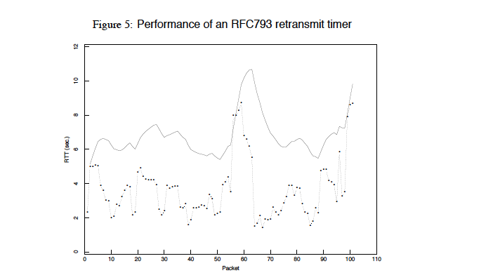
Karn/Partridge in action
from Jacobson and Karels, SIGCOMM 1988

Slide 103
Jacobson/Karels Algorithm
Problem: need to better capture variability in RTT
Directly measure deviation
Deviation = | SampleRTT – EstimatedRTT |
EstimatedDeviation: exponential average of Deviation
RTO = EstimatedRTT + 4 x EstimatedDeviation

Slide 104
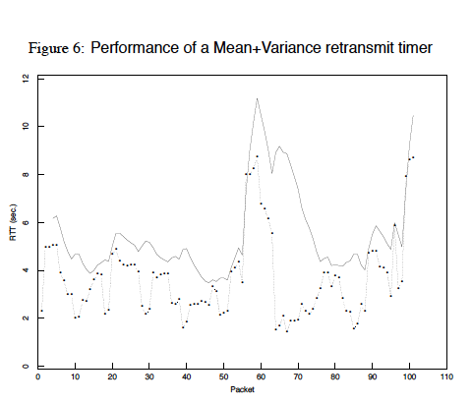
With Jacobson/Karels
Notes:
LOWER ESTIMATE! less “old mass” more reaction but wihout jaggers
2019-02-20

Slide 105
What does TCP do?
Most of our previous ideas, but some key differences
Checksum
Sequence numbers are byte offsets
Receiver sends cumulative acknowledgements (like GBN)
Receivers do not drop out-of-sequence packets (like SR)
Introduces fast retransmit: optimization that uses duplicate ACKs to trigger early retransmission
Sender maintains a single retransmission timer (like GBN) and retransmits on timeout

Slide 106
TCP Header: What’s left?
Source port
Destination port
Sequence number
“Must Be Zero” 6 bits reserved
Acknowledgment
HdrLen
0
Flags
Advertised window
Number of 4-byte words in TCP header; 5 = no options
Checksum
Urgent pointer
Options (variable)
Data
Notes:
2017-2-15bb§bb

Slide 107
TCP Header: What’s left?
Source port
Destination port
Sequence number
Used with URG flag to indicate urgent data (not discussed further)
Acknowledgment
HdrLen
0
Flags
Advertised window
Checksum
Urgent pointer
Options (variable)
Data

Slide 108
TCP Header: What’s left?
Source port
Destination port
Sequence number
Acknowledgment
HdrLen
0
Flags
Advertised window
Checksum
Urgent pointer
Options (variable)
Data

Slide 109
TCP Connection Establishment and Initial Sequence Numbers
Notes:
2016-1-29

Slide 110
Initial Sequence Number (ISN)
Sequence number for the very first byte
Why not just use ISN = 0?
Practical issue
IP addresses and port #s uniquely identify a connection
Eventually, though, these port #s do get used again
… small chance an old packet is still in flight
TCP therefore requires changing ISN
Hosts exchange ISNs when they establish a connection

Slide 111
Establishing a TCP Connection
A
B
SYN
SYN ACK
Each host tells its ISN to the other host.
ACK
Data
Data
Three-way handshake to establish connection
Host A sends a SYN (open; “synchronize sequence numbers”) to host B
Host B returns a SYN acknowledgment (SYN ACK)
Host A sends an ACK to acknowledge the SYN ACK

Slide 112
TCP Header
Source port
Destination port
Sequence number
Flags:
SYN
ACK
FIN
RST
PSH
URG
Acknowledgment
HdrLen
0
Flags
Advertised window
Checksum
Urgent pointer
Options (variable)
Data

Slide 113
Step 1: A’s Initial SYN Packet
A’s port
B’s port
A’s Initial Sequence Number
Flags:
SYN
ACK
FIN
RST
PSH
URG
(Irrelevant since ACK not set)
5
0
Flags
Advertised window
Checksum
Urgent pointer
Options (variable)
A tells B it wants to open a connection…

Slide 114
Step 2: B’s SYN-ACK Packet
B’s port
A’s port
B’s Initial Sequence Number
Flags:
SYN
ACK
FIN
RST
PSH
URG
ACK = A’s ISN plus 1
5
Flags
Advertised window
0
Checksum
Urgent pointer
Options (variable)
B tells A it accepts, and is ready to hear the next byte…
… upon receiving this packet, A can start sending data

Slide 115
Step 3: A’s ACK of the SYN-ACK
A’s port
B’s port
A’s Initial Sequence Number
Flags:
SYN
ACK
FIN
RST
PSH
URG
B’s ISN plus 1
20B
Flags
Advertised window
0
Checksum
Urgent pointer
Options (variable)
A tells B it’s likewise okay to start sending
… upon receiving this packet, B can start sending data

Slide 116
Timing Diagram: 3-Way Handshaking
Passive Open
Active Open
Server
Client (initiator)
listen()
connect()
SYN, SeqNum = x
SYN + ACK, SeqNum = y, Ack = x + 1
ACK, Ack = y + 1

Slide 117
What if the SYN Packet Gets Lost?
Suppose the SYN packet gets lost
Packet is lost inside the network, or:
Server discards the packet (e.g., it’s too busy)
Eventually, no SYN-ACK arrives
Sender sets a timer and waits for the SYN-ACK
… and retransmits the SYN if needed
How should the TCP sender set the timer?
Sender has no idea how far away the receiver is
Hard to guess a reasonable length of time to wait
SHOULD (RFCs 1122 & 2988) use default of 3 seconds
Some implementations instead use 6 seconds

Slide 118
Tearing Down the Connection

Slide 119
Normal Termination, One Side At A Time
B
ACK
SYN
SYN ACK
Data
ACK
FIN
ACK
FIN
ACK
A
time
Finish (FIN) to close and receive remaining bytes
FIN occupies one byte in the sequence space
Other host acks the byte to confirm
Closes A’s side of the connection, but not B’s
Until B likewise sends a FIN
Which A then acks
Connection now closed
Connection now half-closed
TIME_WAIT:
Avoid reincarnation
B will retransmit FIN if ACK is lost
Notes:
Why timer? Will get packet with no state!!

Slide 120
Normal Termination, Both Together
B
ACK
ACK
SYN
SYN ACK
Data
ACK
FIN
FIN + ACK
A
time
TIME_WAIT:
Avoid reincarnation
Can retransmit FIN ACK if ACK lost
Connection now closed
Same as before, but B sets FIN with their ack of A’s FIN

Slide 121
Abrupt Termination
B
ACK
SYN
SYN ACK
ACK
RST
RST
Data
Data
A
time
A sends a RESET (RST) to B
E.g., because application process on A crashed
That’s it
B does not ack the RST
Thus, RST is not delivered reliably
And: any data in flight is lost
But: if B sends anything more, will elicit another RST

Slide 122
TCP State Transitions
Data, ACK exchanges are in here

Slide 123
An Simpler View of the Client Side
CLOSED
SYN (Send)
TIME_WAIT
SYN_SENT
Rcv. FIN, Send ACK
Rcv. SYN+ACK, Send ACK
ESTABLISHED
FIN_WAIT2
FIN_WAIT1
Rcv. ACK, Send Nothing
Send FIN
Notes:
4-feb-2015

Slide 124
TCP Header
Source port
Destination port
Sequence number
Acknowledgment
HdrLen
0
Flags
Advertised window
Checksum
Urgent pointer
Options (variable)
Data

Slide 125
What does TCP do?
ARQ windowing, set-up, tear-down
Flow Control in TCP

Slide 126
Recap: Sliding Window (so far)
Both sender & receiver maintain a window
Left edge of window:
Sender: beginning of unacknowledged data
Receiver: beginning of undelivered data
Right edge: Left edge + constant
constant only limited by buffer size in the transport layer
Notes:
Picture on board

Slide 127
Sliding Window at Sender (so far)
Sending process
TCP
Buffer size (B)
Last byte written
Previously
ACKed bytes
First unACKed byte
Last byte can send

Slide 128
Sliding Window at Receiver (so far)
Receiving process
Last byte read
Buffer size (B)
Received and ACKed
Sender might overrun the receiver’s buffer
Next byte needed (1st byte not received)
Last byte received

Slide 129
Solution: Advertised Window (Flow Control)
Receiver uses an “Advertised Window” (W) to prevent sender from overflowing its window
Receiver indicates value of W in ACKs
Sender limits number of bytes it can have in flight <= W

Slide 130
Sliding Window at Receiver
W= B - (LastByteReceived - LastByteRead)
Receiving process
Last byte read
Buffer size (B)
Next byte needed (1st byte not received)
Last byte received

Slide 131
Sliding Window at Sender (so far)
Sending process
TCP
W
Last byte written
First unACKed byte
Last byte can send

Slide 132
Sliding Window w/ Flow Control
Sender: window advances when new data ack’d
Receiver: window advances as receiving process consumes data
Receiver advertises to the sender where the receiver window currently ends (“righthand edge”)
Sender agrees not to exceed this amount

Slide 133
Advertised Window Limits Rate
Sender can send no faster than W/RTT bytes/sec
Receiver only advertises more space when it has consumed old arriving data
In original TCP design, that was the sole protocol mechanism controlling sender’s rate
What’s missing?

Slide 134
TCP
The concepts underlying TCP are simple
acknowledgments (feedback)
timers
sliding windows
buffer management
sequence numbers

Slide 135
Sizing Windows for Congestion Control
What are the problems?
How might we address them?

Slide 136
What does TCP do?
ARQ windowing, set-up, tear-down
Flow Control in TCP
Congestion Control in TCP

Slide 137
We have seen:
Flow control: adjusting the sending rate to keep from overwhelming a slow receiver
Now lets attend…
Congestion control: adjusting the sending rate to keep from overloading the network
Notes:
2020-3-5

Slide 138
Statistical Multiplexing → Congestion
If two packets arrive at the same time
A router can only transmit one
… and either buffers or drops the other
If many packets arrive in a short period of time
The router cannot keep up with the arriving traffic
… delays traffic, and the buffer may eventually overflow
Internet traffic is bursty

Slide 139
Congestion is undesirable
Typical queuing system with bursty arrivals
Average
Packet delay
Average
Packet loss
Load
Load
Must balance utilization versus delay and loss

Slide 140
Who Takes Care of Congestion?
Network? End hosts? Both?
TCP’s approach:
End hosts adjust sending rate
Based on implicit feedback from network
Not the only approach
A consequence of history rather than planning
Notes:
2019-2-21

Slide 141
Some History: TCP in the 1980s
Sending rate only limited by flow control
Packet drops → senders (repeatedly!) retransmit a full window’s worth of packets
Led to “congestion collapse” starting Oct. 1986
Throughput on the NSF network dropped from 32Kbits/s to 40bits/sec
“Fixed” by Van Jacobson’s development of TCP’s congestion control (CC) algorithms

Slide 142
Jacobson’s Approach
Extend TCP’s existing window-based protocol but adapt the window size in response to congestion
required no upgrades to routers or applications!
patch of a few lines of code to TCP implementations
A pragmatic and effective solution
but many other approaches exist
Extensively improved on since
topic now sees less activity in ISP contexts
but is making a comeback in datacenter environments

Slide 143
Three Issues to Consider
Discovering the available (bottleneck) bandwidth
Adjusting to variations in bandwidth
Sharing bandwidth between flows

Slide 144
Abstract View
Ignore internal structure of router and model it as having a single queue for a particular input-output pair
A
B
Sending Host
Buffer in Router
Receiving Host

Slide 145
Discovering available bandwidth
Pick sending rate to match bottleneck bandwidth
Without any a priori knowledge
Could be gigabit link, could be a modem
A
100 Mbps
B

Slide 146
Adjusting to variations in bandwidth
Adjust rate to match instantaneous bandwidth
Assuming you have rough idea of bandwidth
BW(t)
A
B

Slide 147
Multiple flows and sharing bandwidth
Two Issues:
Adjust total sending rate to match bandwidth
Allocation of bandwidth between flows
A1
B1
A2
BW(t)
B2
A3
B3

Slide 148
Reality
Congestion control is a resource allocation problem involving many flows, many links, and complicated global dynamics

Slide 149
View from a single flow
packet
loss
knee
cliff
Knee – point after which
Throughput increases slowly
Delay increases fast
Cliff – point after which
Throughput starts to drop to zero (congestion collapse)
Delay approaches infinity
Throughput
congestion
collapse
Load
Delay
Load

Slide 150
General Approaches
(0) Send without care
Many packet drops

Slide 151
General Approaches
(0) Send without care
(1) Reservations
Pre-arrange bandwidth allocations
Requires negotiation before sending packets
Low utilization

Slide 152
General Approaches
(0) Send without care
(1) Reservations
(2) Pricing
Don’t drop packets for the high-bidders
Requires payment model

Slide 153
General Approaches
(0) Send without care
(1) Reservations
(2) Pricing
(3) Dynamic Adjustment
Hosts probe network; infer level of congestion; adjust
Network reports congestion level to hosts; hosts adjust
Combinations of the above
Simple to implement but suboptimal, messy dynamics

Slide 154
General Approaches
(0) Send without care
(1) Reservations
(2) Pricing
(3) Dynamic Adjustment
All three techniques have their place
Generality of dynamic adjustment has proven powerful
Doesn’t presume business model, traffic characteristics, application requirements; does assume good citizenship

Slide 155
TCP’s Approach in a Nutshell
TCP connection has window
Controls number of packets in flight
Sending rate: ~Window/RTT
Vary window size to control sending rate

Slide 156
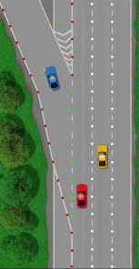

Windows, Buffers, and TCP

Slide 157
Windows, Buffers, and TCP
TCP connection has a window
Controls number of packets in flight;
filling a channel to improve throughput, and
vary window size to control sending rate
Buffers adapt mis-matched channels
Buffers smooth bursts
Adapt (re-time) arrivals for multiplexing

Slide 158

Windows, Buffers, and TCP
Buffers & TCP can make link utilization 100%
but
Buffers add delay, variable delay

Slide 159

Sizing Buffers in Routers
Packet loss
Queue overload, and subsequent packet loss
End-to-end delay
Transmission, propagation, and queueing delay
The only variable part is queueing delay
Router architecture
Board space, power consumption, and cost
On chip buffers: higher density, higher capacity

Slide 160


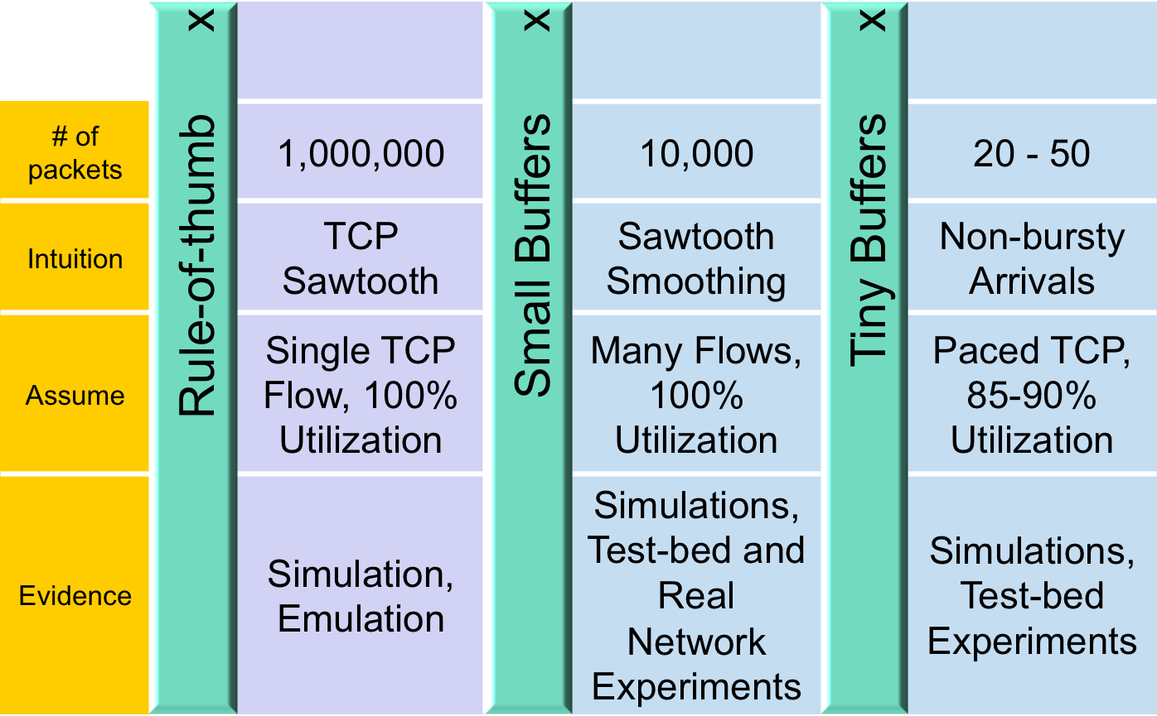
Buffer Sizing Story
Notes:
@transport

Slide 161
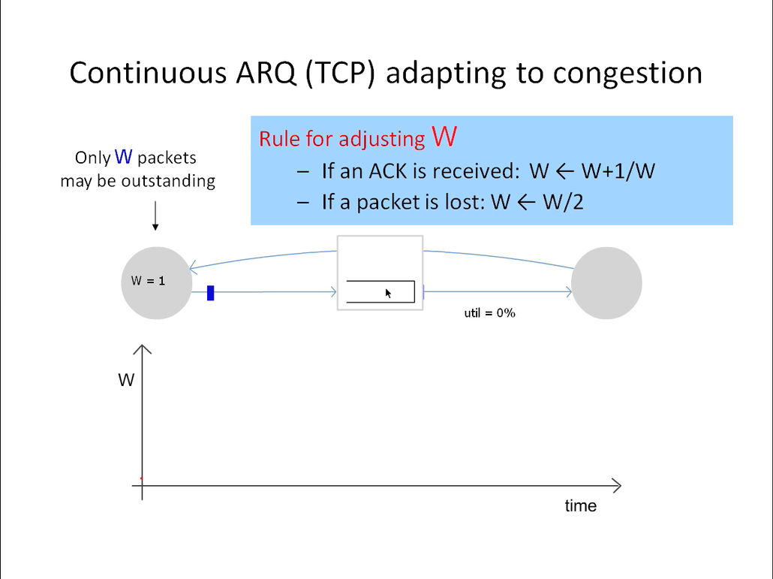
Notes:
@Transport

Slide 162


Slide 163
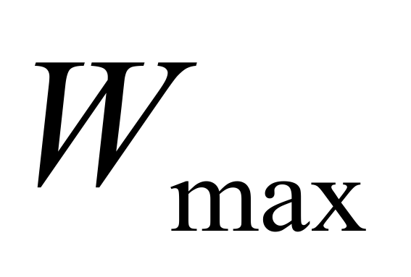
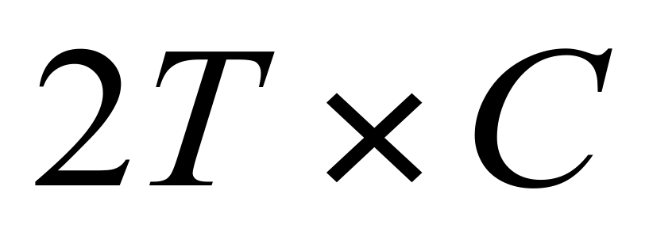
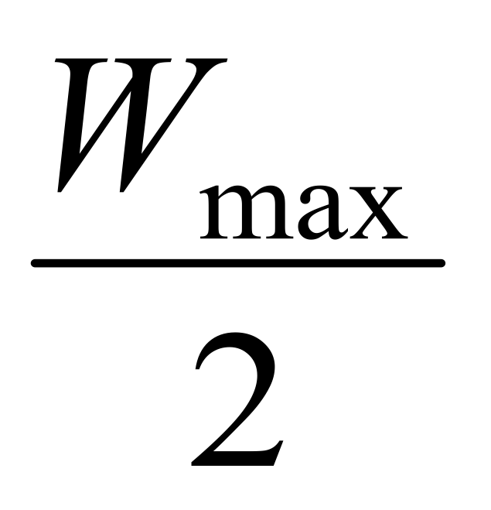
Rule-of-thumb – Intuition
Rule for adjusting W
If an ACK is received: W ← W+1/W
If a packet is lost: W ← W/2
Only W packets may be outstanding
Source
Dest
Window size
t
Notes:
@transport

Slide 164
Buffers in Routers So how large should the buffers be?
Buffer size matters
Packet loss
Queue overload, and subsequent packet loss
End-to-end delay
Transmission, propagation, and queueing delay
The only variable part is queueing delay

Slide 165

Buffer Sizing Story
Notes:
@transport

Slide 166
Buffers in Routers So how large should the buffers be?
Buffer size matters
Packet loss
Queue overload, and subsequent packet loss
End-to-end delay
Transmission, propagation, and queueing delay
The only variable part is queueing delay
Router architecture
Board space, power consumption, and cost
On chip buffers: higher density, higher capacity

Slide 167
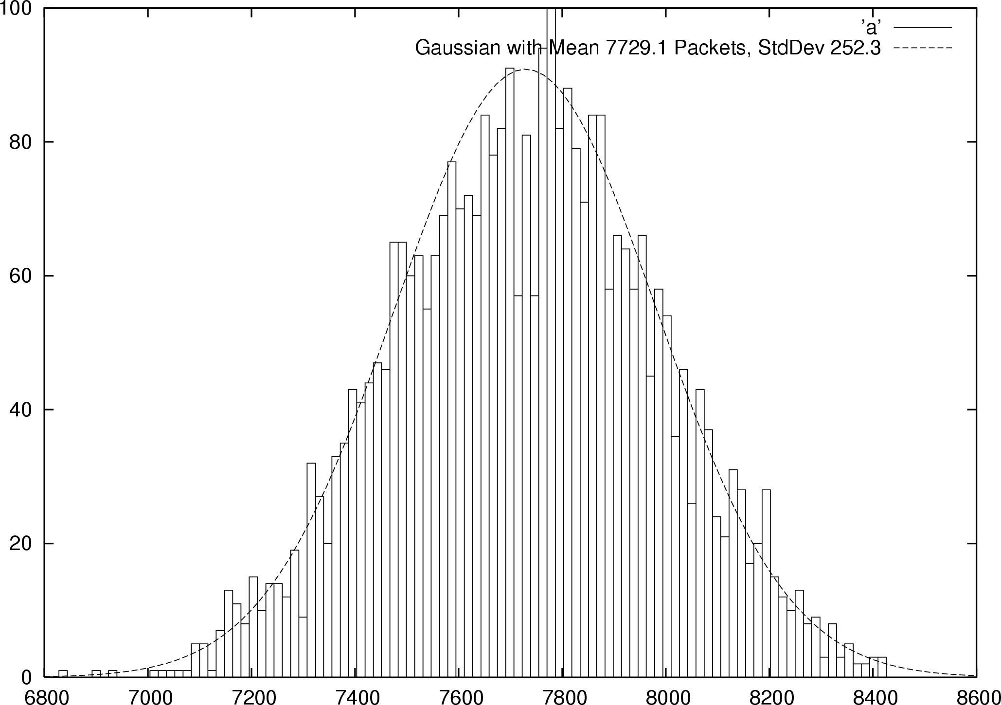
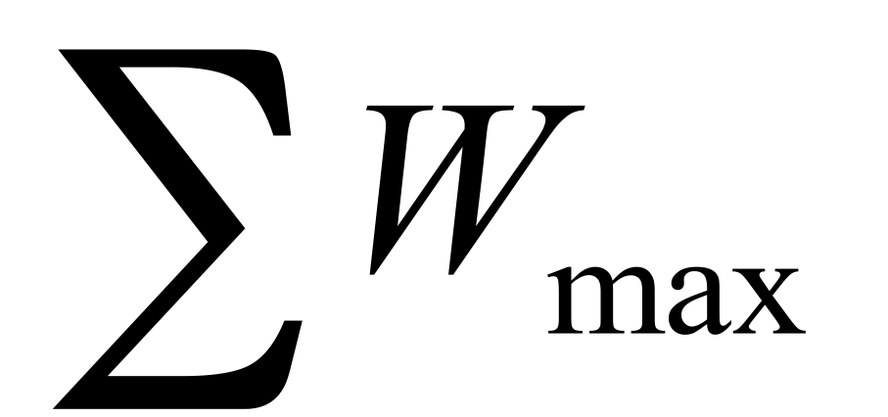

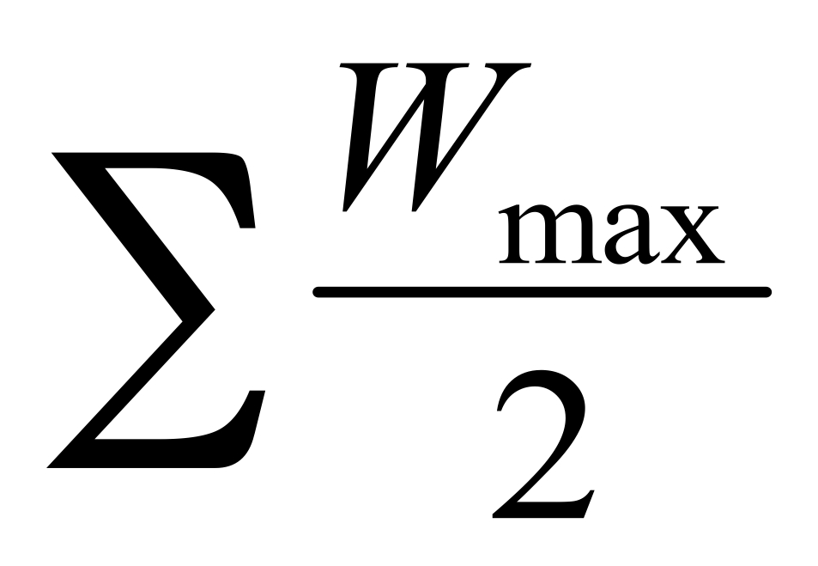
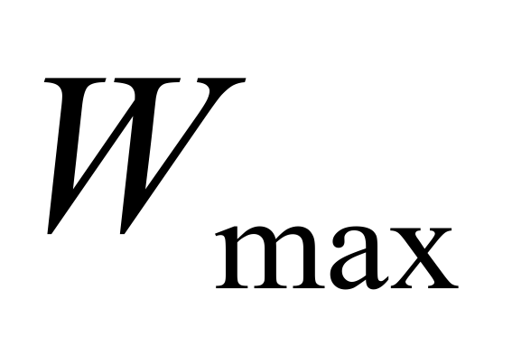
Small Buffers – Intuition
Synchronized Flows
Many TCP Flows
Aggregate window has same dynamics
Therefore buffer occupancy has same dynamics
Rule-of-thumb still holds.
Independent, desynchronized
Central limit theorem says the aggregate becomes Gaussian
Variance (buffer size) decreases as N increases
Buffer Size
Probability
Distribution
t
t
Notes:
@transport

Slide 168

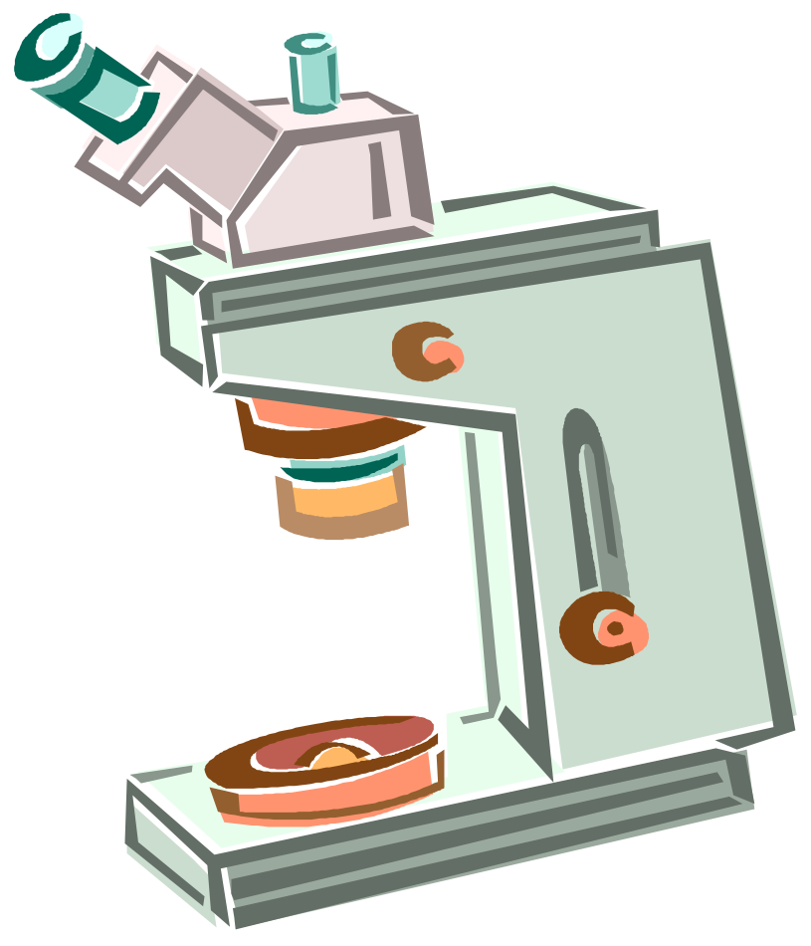
Buffer Sizing Story
What size do we make the buffer?
Well it depends…
One TCP connection?
Many Synchronized TCP connections?
Just TCP – what about other applications?
Small BDP link?
Large BDP link?
How many devices?
W of flows?
How many flows?
How much do you know about your traffic?
What is best for your traffic?
Notes:
@transport

Slide 169
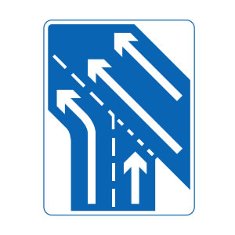
TCP’s Approach in a Nutshell
TCP connection has window
Controls number of packets in flight
Sending rate: ~Window/RTT
Vary window size to control sending rate

Slide 170
All These Windows…
Congestion Window: CWND
How many bytes can be sent without overflowing routers
Computed by the sender using congestion control algorithm
Flow control window: AdvertisedWindow (RWND)
How many bytes can be sent without overflowing receiver’s buffers
Determined by the receiver and reported to the sender
Sender-side window = minimum{CWND,RWND}
Assume for this material that RWND >> CWND

Slide 171
Note
This lecture will talk about CWND in units of MSS
(Recall MSS: Maximum Segment Size, the amount of payload data in a TCP packet)
This is only for pedagogical purposes
In reality this is a LIE: Real implementations maintain CWND in bytes

Slide 172
Two Basic Questions
How does the sender detect congestion?
How does the sender adjust its sending rate?
To address three issues
Finding available bottleneck bandwidth
Adjusting to bandwidth variations
Sharing bandwidth

Slide 173
Detecting Congestion
Packet delays
Tricky: noisy signal (delay often varies considerably)
Router tell end-hosts they’re congested
Packet loss
Fail-safe signal that TCP already has to detect
Complication: non-congestive loss (checksum errors)
Two indicators of packet loss
No ACK after certain time interval: timeout
Multiple duplicate ACKs

Slide 174
Not All Losses the Same
Duplicate ACKs: isolated loss
Still getting ACKs
Timeout: much more serious
Not enough packets in progress to trigger duplicate-acks, OR
Suffered several losses
We will adjust rate differently for each case
Notes:
2017-2-17

Slide 175
Rate Adjustment
Basic structure:
Upon receipt of ACK (of new data): increase rate
Upon detection of loss: decrease rate
How we increase/decrease the rate depends on the phase of congestion control we’re in:
Discovering available bottleneck bandwidth vs.
Adjusting to bandwidth variations

Slide 176
Bandwidth Discovery with Slow Start
Goal: estimate available bandwidth
start slow (for safety)
but ramp up quickly (for efficiency)
Consider
RTT = 100ms, MSS=1000bytes
Window size to fill 1Mbps of BW = 12.5 packets
Window size to fill 1Gbps = 12,500 packets
Either is possible!

Slide 177
“Slow Start” Phase
Sender starts at a slow rate but increases exponentially until first loss
Start with a small congestion window
Initially, CWND = 1
So, initial sending rate is MSS/RTT
Double the CWND for each RTT with no loss
Notes:
MSS vs MTU??

Slide 178
Slow Start in Action
For each RTT: double CWND
Simpler implementation: for each ACK, CWND += 1
1
2
3
4
8
Src
D
A
D
D
A
A
D
D
D
D
A
A
A
A
Dest

Slide 179
Adjusting to Varying Bandwidth
Slow start gave an estimate of available bandwidth
Now, want to track variations in this available bandwidth, oscillating around its current value
Repeated probing (rate increase) and backoff (rate decrease)
TCP uses: “Additive Increase Multiplicative Decrease” (AIMD)
We’ll see why shortly…

Slide 180
AIMD
Additive increase
Window grows by one MSS for every RTT with no loss
For each successful RTT, CWND = CWND + 1
Simple implementation:
for each ACK, CWND = CWND+ 1/CWND
Multiplicative decrease
On loss of packet, divide congestion window in half
On loss, CWND = CWND/2

Slide 181
Leads to the TCP “Sawtooth”
Window
Loss
Exponential “slow start”
t

Slide 182
Slow-Start vs. AIMD
When does a sender stop Slow-Start and start Additive Increase?
Introduce a “slow start threshold” (ssthresh)
Initialized to a large value
On timeout, ssthresh = CWND/2
When CWND = ssthresh, sender switches from slow-start to AIMD-style increase
182

Slide 183
What does TCP do?
ARQ windowing, set-up, tear-down
Flow Control in TCP
Congestion Control in TCP
AIMD

Slide 184
What does TCP do?
ARQ windowing, set-up, tear-down
Flow Control in TCP
Congestion Control in TCP
AIMD, Fast-Recovery

Slide 185
One Final Phase: Fast Recovery
The problem: congestion avoidance too slow in recovering from an isolated loss

Slide 186
Example (in units of MSS, not bytes)
Consider a TCP connection with:
CWND=10 packets
Last ACK was for packet # 101
i.e., receiver expecting next packet to have seq. no. 101
10 packets [101, 102, 103,…, 110] are in flight
Packet 101 is dropped
What ACKs do they generate?
And how does the sender respond?

Slide 187
The problem – A timeline
ACK 101 (due to 102) cwnd=10 dupACK#1 (no xmit)
ACK 101 (due to 103) cwnd=10 dupACK#2 (no xmit)
ACK 101 (due to 104) cwnd=10 dupACK#3 (no xmit)
RETRANSMIT 101 ssthresh=5 cwnd= 5
ACK 101 (due to 105) cwnd=5 + 1/5 (no xmit)
ACK 101 (due to 106) cwnd=5 + 2/5 (no xmit)
ACK 101 (due to 107) cwnd=5 + 3/5 (no xmit)
ACK 101 (due to 108) cwnd=5 + 4/5 (no xmit)
ACK 101 (due to 109) cwnd=5 + 5/5 (no xmit)
ACK 101 (due to 110) cwnd=6 + 1/5 (no xmit)
ACK 111 (due to 101) ⬅ only now can we transmit new packets
Plus no packets in flight so ACK “clocking” (to increase CWND) stalls for another RTT

Slide 188
Solution: Fast Recovery
Idea: Grant the sender temporary “credit” for each dupACK so as to keep packets in flight
If dupACKcount = 3
ssthresh = cwnd/2
cwnd = ssthresh + 3
While in fast recovery
cwnd = cwnd + 1 for each additional duplicate ACK
Exit fast recovery after receiving new ACK
set cwnd = ssthresh

Slide 189
Example
Consider a TCP connection with:
CWND=10 packets
Last ACK was for packet # 101
i.e., receiver expecting next packet to have seq. no. 101
10 packets [101, 102, 103,…, 110] are in flight
Packet 101 is dropped

Slide 190
Timeline
ACK 101 (due to 102) cwnd=10 dup#1
ACK 101 (due to 103) cwnd=10 dup#2
ACK 101 (due to 104) cwnd=10 dup#3
REXMIT 101 ssthresh=5 cwnd= 8 (5+3)
ACK 101 (due to 105) cwnd= 9 (no xmit)
ACK 101 (due to 106) cwnd=10 (no xmit)
ACK 101 (due to 107) cwnd=11 (xmit 111)
ACK 101 (due to 108) cwnd=12 (xmit 112)
ACK 101 (due to 109) cwnd=13 (xmit 113)
ACK 101 (due to 110) cwnd=14 (xmit 114)
ACK 111 (due to 101) cwnd = 5 (xmit 115) ⬅ exiting fast recovery
Packets 111-114 already in flight
ACK 112 (due to 111) cwnd = 5 + 1/5 ← back in congestion avoidance

Slide 191
Putting it all together: The TCP State Machine (partial)
timeout
congstn. avoid.
new ACK
slow start
cwnd > ssthresh
timeout
new ACK
timeout
new ACK
dupACK=3
dupACK=3
fast recovery
dupACK
How are ssthresh, CWND and dupACKcount updated for each event that causes a state transition?

Slide 192
TCP Flavors
TCP-Tahoe
cwnd =1 on triple dupACK
TCP-Reno
cwnd =1 on timeout
cwnd = cwnd/2 on triple dupack
TCP-newReno
TCP-Reno + improved fast recovery
TCP-SACK
incorporates selective acknowledgements

Slide 193
What does TCP do?
ARQ windowing, set-up, tear-down
Flow Control in TCP
Congestion Control in TCP
AIMD, Fast-Recovery, Throughput

Slide 194
TCP Flavors
TCP-Tahoe
CWND =1 on triple dupACK
TCP-Reno
CWND =1 on timeout
CWND = CWND/2 on triple dupack
TCP-newReno
TCP-Reno + improved fast recovery
TCP-SACK
incorporates selective acknowledgements
Our default assumption

Slide 195
Interoperability
How can all these algorithms coexist? Don’t we need a single, uniform standard?
What happens if I’m using Reno and you are using Tahoe, and we try to communicate?

Slide 196
TCP Throughput Equation
Notes:
Sort out the replication. XXXX
2019-2-22

Slide 197
A Simple Model for TCP Throughput
cwnd
Loss
½ W_{max} RTTs between drops
A
1
t
RTT
Avg. ¾ W_{max} packets per RTTs

Slide 198
A Simple Model for TCP Throughput
cwnd
Loss
A
t

Slide 199
Implications (1): Different RTTs
Flows get throughput inversely proportional to RTT
TCP unfair in the face of heterogeneous RTTs!
A1
B1
100ms
200ms
A2
bottleneck
link
B2

Slide 200
Implications (2): High Speed TCP
Assume RTT = 100ms, MSS=1500bytes
What value of p is required to reach 100Gbps throughput
~ 2 x 10⁻¹²
How long between drops?
~ 16.6 hours
How much data has been sent in this time?
~ 6 petabits
These are not practical numbers!

Slide 201
Adapting TCP to High Speed
Once past a threshold speed, increase CWND faster
A proposed standard [Floyd’03]: once speed is past some threshold, change equation to p^{-.8} rather than p^{-.5}
Let the additive constant in AIMD depend on CWND
Other approaches?
Multiple simultaneous connections (hacky but works today)
Router-assisted approaches (will see shortly)
Notes:
2020-3-6

Slide 202
Implications (3): Rate-based CC
TCP throughput is “choppy”
repeated swings between W/2 to W
Some apps would prefer sending at a steady rate
e.g., streaming apps
A solution: “Equation-Based Congestion Control”
ditch TCP’s increase/decrease rules and just follow the equation
measure drop percentage p, and set rate accordingly
Following the TCP equation ensures we’re “TCP friendly”
i.e., use no more than TCP does in similar setting

Slide 203
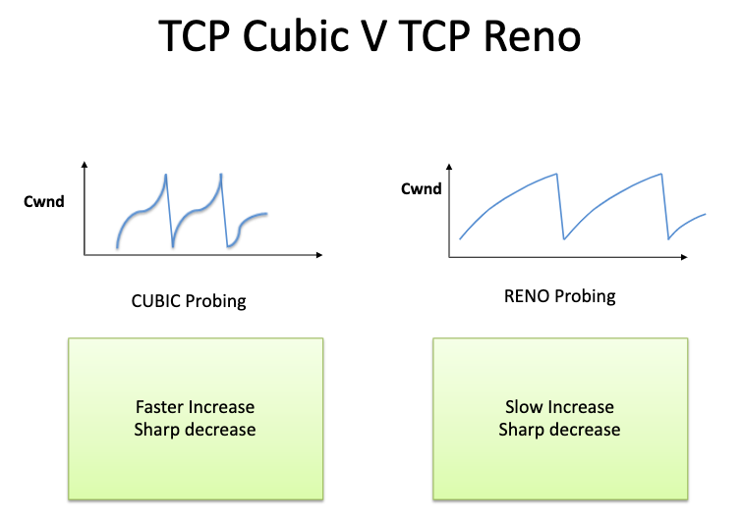

Slide 204
New world of fairness….

Slide 206
Recap: TCP problems
Routers tell endpoints if they’re congested
Misled by non-congestion losses
Fills up queues leading to high delays
Short flows complete before discovering available capacity
AIMD impractical for high speed links
Sawtooth discovery too choppy for some apps
Unfair under heterogeneous RTTs
Tight coupling with reliability mechanisms
Endhosts can cheat
Routers tell endpoints what rate to send at
Routers enforce fair sharing
Could fix many of these with some help from routers!

Slide 207
Router-Assisted Congestion Control
Three tasks for CC:
Isolation/fairness
Adjustment*
Detecting congestion
* This may be automatic eg loss-response of TCP

Slide 208
How can routers ensure each flow gets its “fair share”?

Slide 209
Fairness: General Approach
Routers classify packets into “flows”
(For now) flows are packets between same source/destination
Each flow has its own FIFO queue in router
Router services flows in a fair fashion
When line becomes free, take packet from next flow in a fair order
What does “fair” mean exactly?

Slide 210
Max-Min Fairness
Given set of bandwidth demands r_{i} and total bandwidth C, max-min bandwidth allocations are:
a_{i} = min(f, r_{i})
where f is the unique value such that Sum(a_{i}) = C
r₁
?
r₂
C bits/s
?
r₃
?
210

Slide 211
Example
C = 10; r₁ = 8, r₂ = 6, r₃ = 2; N = 3
C/3 = 3.33 →
Can service all of r₃
Remove r₃ from the accounting: C = C – r₃ = 8; N = 2
C/2 = 4 →
Can’t service all of r₁ or r₂
So hold them to the remaining fair share: f = 4
8
f = 4:
min(8, 4) = 4
min(6, 4) = 4
min(2, 4) = 2
10
4
6
4
2
2

Slide 212
Max-Min Fairness
Given set of bandwidth demands r_{i} and total bandwidth C, max-min bandwidth allocations are:
a_{i} = min(f, r_{i})
where f is the unique value such that Sum(a_{i}) = C
Property:
If you don’t get full demand, no one gets more than you
This is what round-robin service gives if all packets are the same size

Slide 213
How do we deal with packets of different sizes?
Mental model: Bit-by-bit round robin (“fluid flow”)
Can you do this in practice?
No, packets cannot be preempted
But we can approximate it
This is what “fair queuing” routers do

Slide 214
Fair Queuing (FQ)
For each packet, compute the time at which the last bit of a packet would have left the router if flows are served bit-by-bit
Then serve packets in the increasing order of their deadlines

Slide 215
Example
Flow 1
(arrival traffic)
1
2
3
4
5
6
time
Flow 2
(arrival traffic)
1
2
3
4
5
time
Service
in fluid flow
system
1
2
1
2
3
4
5
6
3
4
5
time
FQ Packet
system
1
2
1
3
2
3
4
4
5
5
6
time

Slide 216
Fair Queuing (FQ)
Think of it as an implementation of round-robin generalized to the case where not all packets are equal sized
Weighted fair queuing (WFQ): assign different flows different shares
Today, some form of WFQ implemented in almost all routers
Not the case in the 1980-90s, when CC was being developed
Mostly used to isolate traffic at larger granularities (e.g., per-prefix)

Slide 217
FQ vs. FIFO
FQ advantages:
Isolation: cheating flows don’t benefit
Bandwidth share does not depend on RTT
Flows can pick any rate adjustment scheme they want
Disadvantages:
More complex than FIFO: per flow queue/state, additional per-packet book-keeping

Slide 218
FQ in the big picture
FQ does not eliminate congestion → it just manages the congestion
5Gbps
100Mbps
1Gbps
1Gbps
Will drop an additional 400Mbps from the green flow
1Gbps
Blue and Green get 0.5Gbps; any excess will be dropped
If the green flow doesn’t drop its sending rate to 100Mbps, we’re wasting 400Mbps that could be usefully given to the blue flow

Slide 219
FQ in the big picture
FQ does not eliminate congestion → it just manages the congestion
robust to cheating, variations in RTT, details of delay, reordering, retransmission, etc.
But congestion (and packet drops) still occurs
And we still want end-hosts to discover/adapt to their fair share!
What would the end-to-end argument say w.r.t. congestion control?

Slide 220
Fairness is a controversial goal
What if you have 8 flows, and I have 4?
Why should you get twice the bandwidth
What if your flow goes over 4 congested hops, and mine only goes over 1?
Why shouldn’t you be penalized for using more scarce bandwidth?
And what is a flow anyway?
TCP connection
Source-Destination pair?
Source?

Slide 221
Explicit Congestion Notification (ECN)
Single bit in packet header; set by congested routers
If data packet has bit set, then ACK has ECN bit set
Many options for when routers set the bit
tradeoff between (link) utilization and (packet) delay
Congestion semantics can be exactly like that of drop
I.e., endhost reacts as though it saw a drop
Advantages:
Don’t confuse corruption with congestion; recovery w/ rate adjustment
Can serve as an early indicator of congestion to avoid delays
Easy (easier) to incrementally deploy
defined as extension to TCP/IP in RFC 3168 (uses diffserv bits in the IP header)

Slide 222
TCP in detail
What does TCP do?
ARQ windowing, set-up, tear-down
Flow Control in TCP
Congestion Control in TCP
AIMD, Fast-Recovery, Throughput
Limitations of TCP Congestion Control
Router-assisted Congestion Control (eg ECN)

Slide 223
Transport Recap
A “big bag”:
Multiplexing, reliability, error-detection, error-recovery,
flow and congestion control, ….
UDP:
Minimalist - multiplexing and error detection
TCP:
somewhat hacky
but practical/deployable
good enough to have raised the bar for the deployment of new, more optimal, approaches
though the needs of datacenters might change the status quos
Beyond TCP (discussed in Topic 6):
QUIC / application-aware transport layers

